Slide 1
NEO4J CYPHER TUTORIAL WITH PYTHON
Data Analysis From Neo4j Graph Using Pandas
Tutorial 78

Slide 2
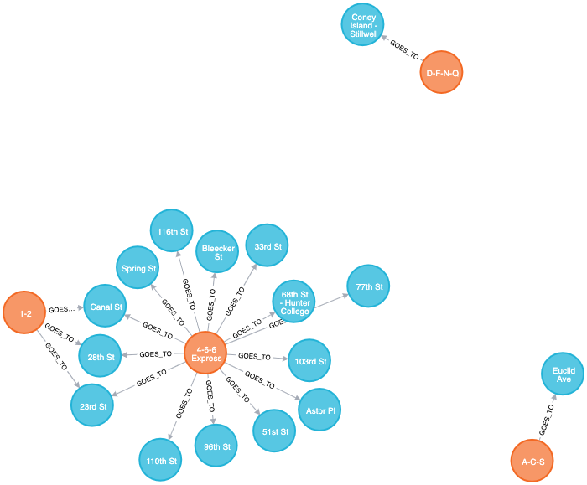
Sample Graph For NEW YORK METRO

Slide 3
USE CASE
TRAIN NAMES AS PER THE CONNECTIVITY COUNT
STATION NAMES AS PER THE CONNECTIVITY COUNT

Slide 4

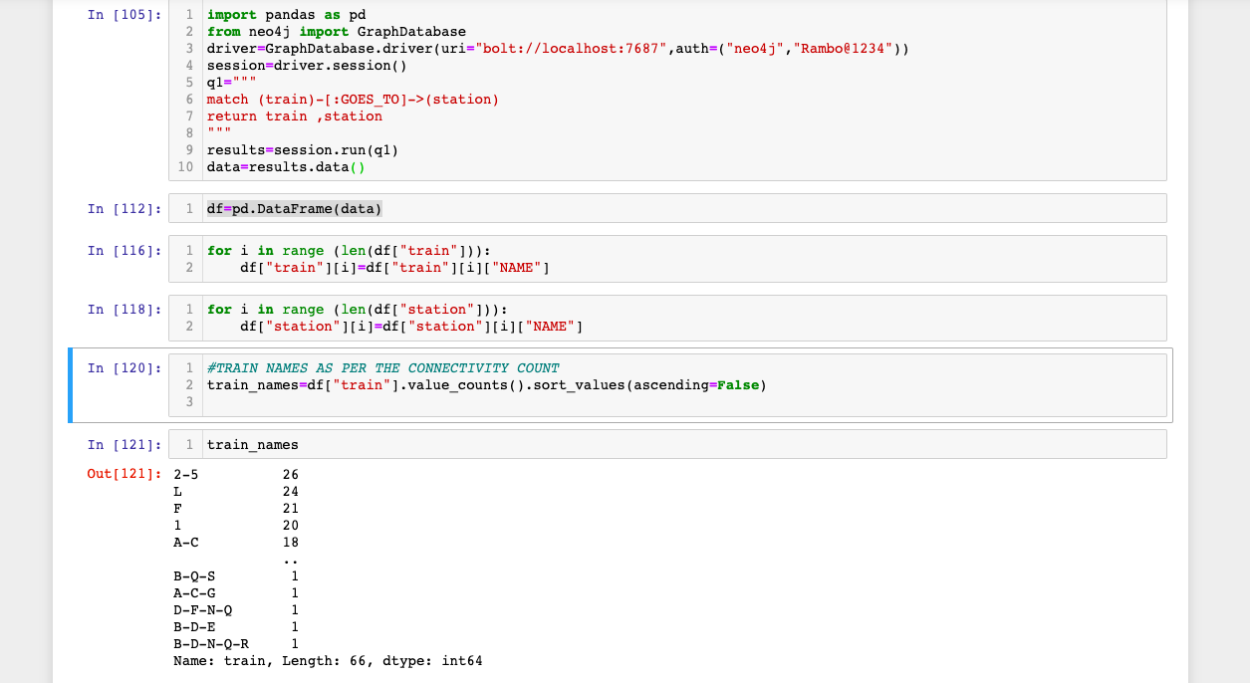
code

Slide 5
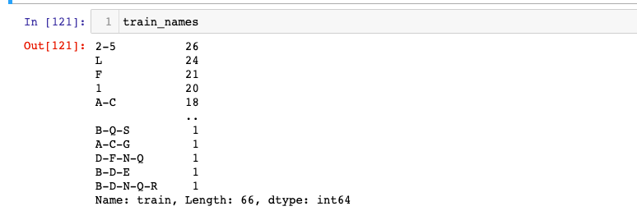
output

